Slide 1
Lecture 5 Feature Engineering
CS582
Machine Learning: Getting Computers
to Program Themselves
“Discovering the Learning Dynamics of the Laws of Nature”
Dr. Emdad Khan
ekhan@miu.edu
Prof. Dept. of Computer Science
Maharishi International University
May, 2023

Slide 2
What is Feature Engineering - 1
Real world data collected from various sources are usually not nice and clean
To ensure Machine Learning (ML) can learn from the data, we need to make sure that data are nice and clean, have good properties and such properties are good for learning
We also need to make sure that we provide enough number of good important features BUT not too many features (refer to the Dimensionality reduction in last lecture)

Slide 3
What is Feature Engineering - 2
Consider a ball which has diameter, shape (e.g. round), weight and color. These can be considered as features to learn about a ball.
Does ML need all these features to learn?
Not necessarily – e.g. color and weight may not be needed!
Can we use arc, edge as features?
Probably, but will that be good?
Finding the correct type, form, format & number of features etc. is an example of Feature Engineering

Slide 4
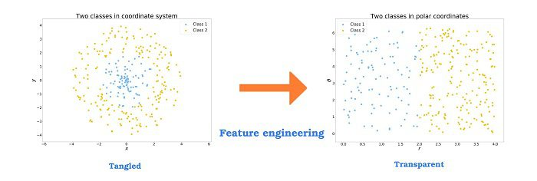
Feature Engineering - A Simple Example
Data on the left Fig. is hard to separate / classify.
Data on the right Fig. is easy to classify after some Transformation
Transform data making it Easier to Interpret

Slide 5
Feature Engineering – More Formal Definition
Feature engineering is the ‘art’ of formulating useful features from existing data following the target to be learned and the machine learning model used.
It involves transforming data to forms that better relate to the underlying target to be learned.
Good Feature engineering can augment the value of existing data and improve the performance of machine learning models.
On the other hand, using bad features may require to build much more complex models to achieve the same level of performance.
There is theoretical framework for Feature Engineering, which is why it has maintained its status as a concept that eludes many.

Slide 6
Feature Engineering – In a Nutshell
Feature Engineering is the process of selecting, transforming, extracting, combining, and manipulating raw data to generate the desired variables for analysis or predictive modeling.
It is a crucial step in developing a machine learning model

Slide 7
Iterative Process of Feature Engineering - 1
Brainstorm features: Really get into the problem, look at a lot of data, study feature engineering on other problems and see what you can steal.
Devise features: Depends on your problem, but you may use automatic feature extraction, manual feature construction and mixtures of the two.
Select features: Use different feature importance scorings and feature selection methods to prepare one or more “views” for your models to operate upon.
Evaluate models: Estimate model accuracy on unseen data using the chosen features.
Iterate as appropriate

Slide 8
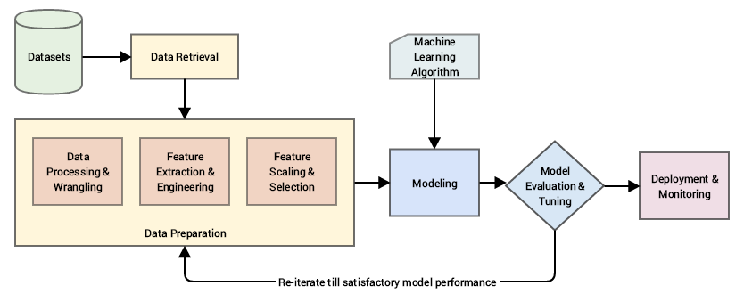
Iterative Process of Feature Engineering - 2

Slide 9
Feature Engineering – Major Types -1
Variable transformation - e.g. normalizing skewed data. One such popularly used transformation is the logarithmic transformation.
Feature scaling - done owing to the sensitivity of some machine learning algorithms to the scale input values. Example - Min-Max Scaling: rescaling of all values in a feature in the range 0 to 1
Feature creation - involves deriving new features from existing ones. Can be done by various mathematical operations. Examples in next slides
Features Splitting - this can improve the value of the features toward the target to be learned and allow more detailed observation - Examples in next slides

Slide 10
Feature Engineering – Major Types - 2
Categorical encoding - encode categorical features (non-numerical features like names, heights in “tall”, “short” etc. into numerical values e.g. One Hot Encoding. Examples in next slides
Discretization - involves essentially taking a set of values of data and grouping sets of them together in some logical fashion into bins (or buckets). Examples in next slides
Imputation - deals with handling missing values in data. It supports both Categorical & Numerical. Missing values are generally replaced by the most commonly occurring value in other records.
Outliers – these are unusually high or low values in the dataset meaning these are outside the range. Outliers are handled by removing or replacing with some typical values in the range.

Slide 11
Basic Feature Types
Numeric Features
CountOfWord(call)
MessageLength
FirstNumberInMessage
WritingGradeLevel
Binary Features
ContainsWord(call)?
IsLongSMSMessage?
Contains(*#)?
ContainsPunctuation?
Categorical Features
FirstWordPOS ->
  { Verb, Noun, Other }
MessageLength ->
  { Short, Medium, Long, VeryLong }
TokenType ->
  { Number, URL, Word, Phone#, Unknown }
GrammarAnalysis ->
  { Fragment, SimpleSentence, ComplexSentence }

Slide 12
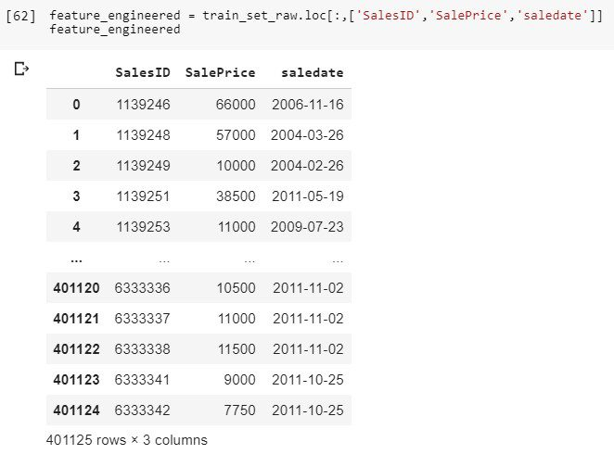
Feature Engineering – Examples
Three data columns from large table

Slide 13
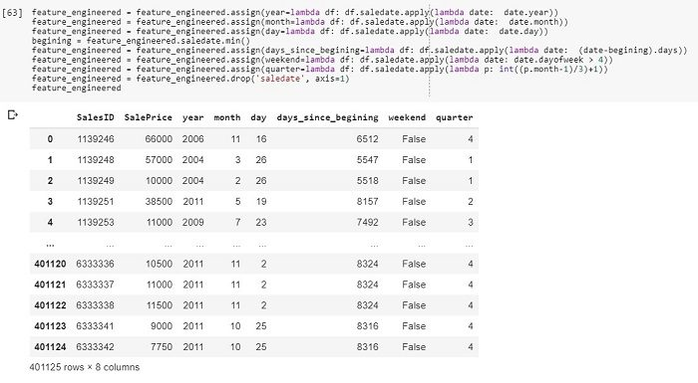
Feature Engineering – Examples
Date is broken in to 6 columns – helping to find more useful data with better formats e.g. year, month, day in separate columns…

Slide 14
Methods to Create / Derive New Features
There are various methods for feature creation / derivation.
Broadly speaking these are classified as Linear and Non-linear

Slide 15
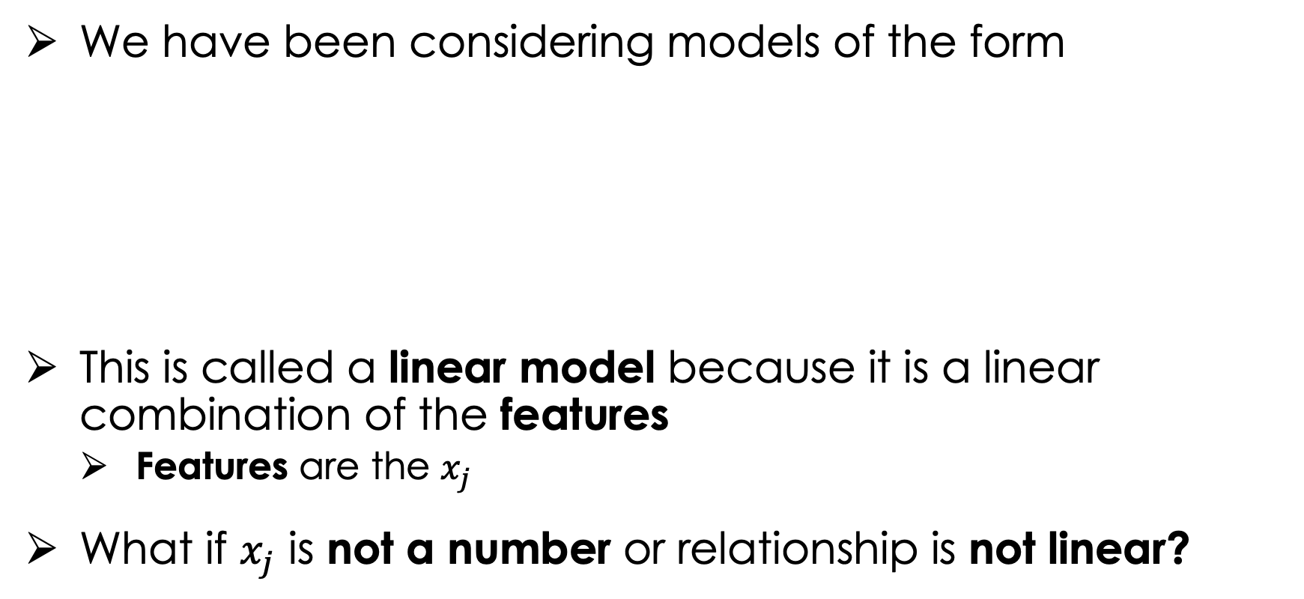
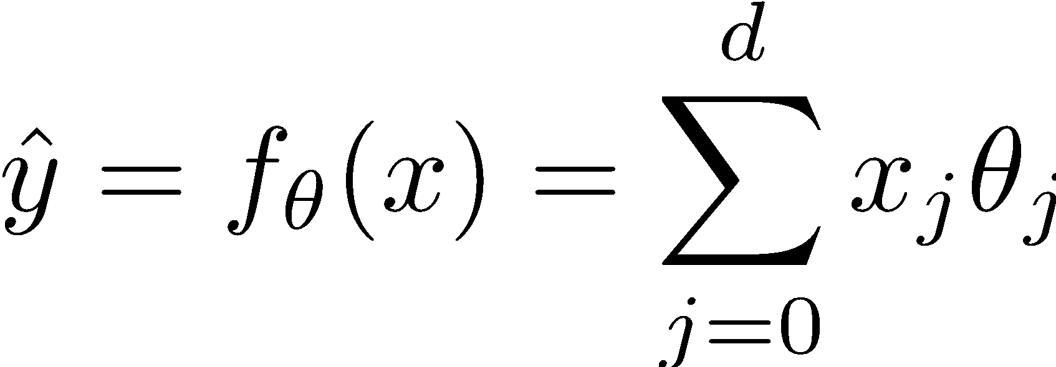
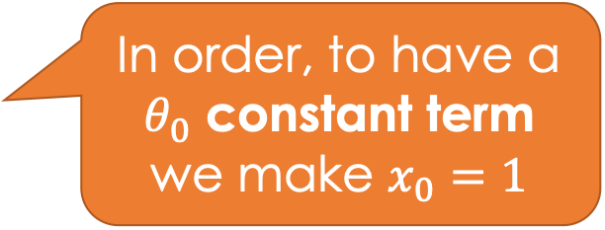
Methods to Create / Derive New Features
Quantitative Continuous

Slide 16



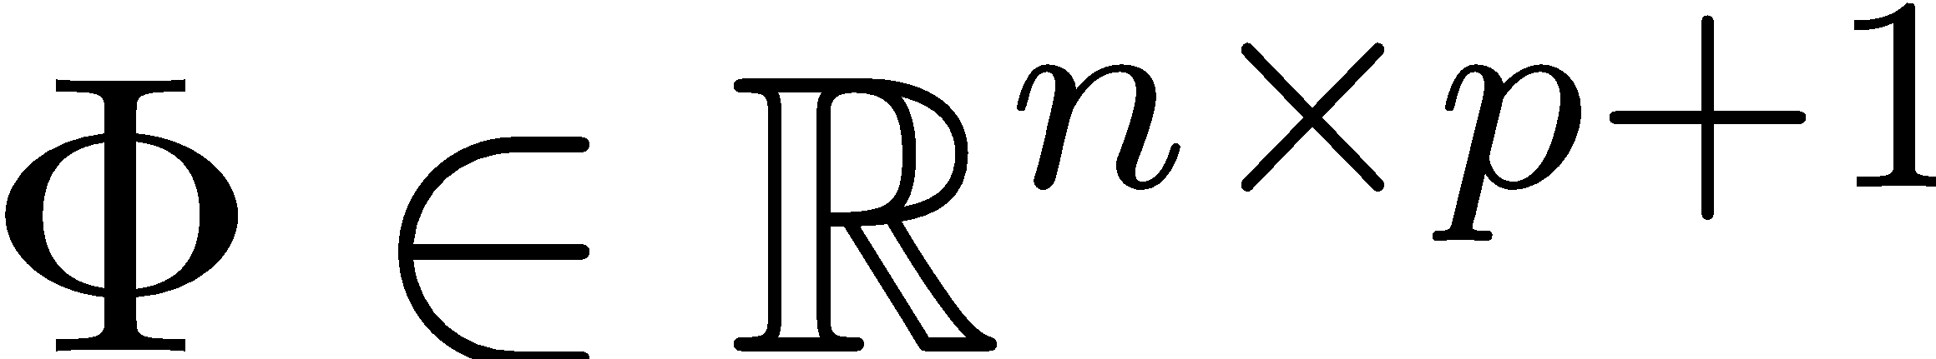


Feature Functions
Feature functions - transform features into new features (linear model)
Domain
DataFrame
Different number
of features
uid | age | state | hasBought | review
0 | 32 | NY | True | ”Meh.”
42 | 50 | WA | True | ”Worked out of the box …”
57 | 16 | CA | NULL | “Hella tots lit...”
Entirely Quantitative and Transformed Values
AK | … | NY | … | WY | age | age^2 | hasBought missing
0 | … | 1 | … | 0 | 32 | 32^2 | 0
0 | … | 0 | … | 0 | 50 | 50^2 | 0
0 | … | 0 | … | 0 | 16 | 16^2 | 1

Slide 17

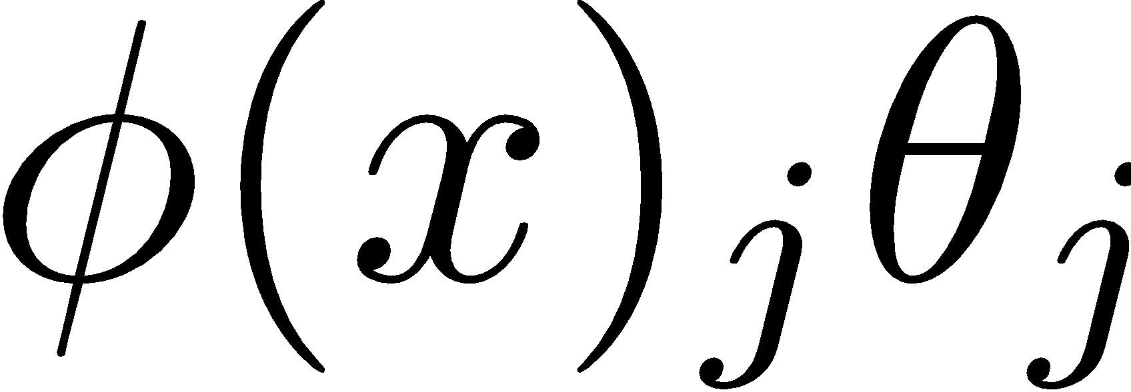
Feature Functions
Feature functions transform features into new features (nonlinear)
(phi)ture function
Designing the feature functions is a big part of machine learning and data science.
Feature Functions
capture domain knowledge
substantial contribute to expressivity (and complexity)
Domain
DataFrame
uid | age | state | hasBought | review
0 | 32 | NY | True | ”Meh.”
42 | 50 | WA | True | ”Worked out of the box …”
57 | 16 | CA | NULL | “Hella tots lit...”
Entirely Quantitative and Transformed Values
AK | … | NY | … | WY | age | age^2 | hasBought missing
0 | … | 1 | … | 0 | 32 | 32^2 | 0
0 | … | 0 | … | 0 | 50 | 50^2 | 0
0 | … | 0 | … | 0 | 16 | 16^2 | 1

Slide 18
Feature Functions
Feature functions transform features into new features.
(phi)ture function
Designing feature functions is a big part of machine learning and data science.
Feature Functions
capture domain knowledge.
substantial contribute to expressivity (and complexity).
Domain
DataFrame
uid | age | state | hasBought | review
0 | 32 | NY | True | ”Meh.”
42 | 50 | WA | True | ”Worked out of the box …”
57 | 16 | CA | NULL | “Hella tots lit...”
Entirely Quantitative and Transformed Values
AK | … | NY | … | WY | age | age^2 | hasBought missing
0 | … | 1 | … | 0 | 32 | 32^2 | 0
0 | … | 0 | … | 0 | 50 | 50^2 | 0
0 | … | 0 | … | 0 | 16 | 16^2 | 1

Slide 19
Feature Engineering – Focus on Domain Knowledge and Relationships

Slide 20


The Constant Feature Function
By adding the all 1s column to our original data we were already introducing a feature function.
Sometimes this feature and it’s parameter are called:
  Constant feature, offset, intercept, bias.
d
1 +
d = p
1
1
1
1
…
n
n

Slide 21
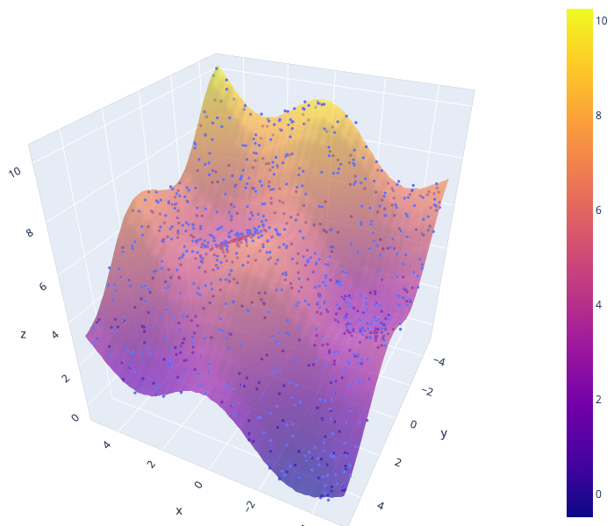
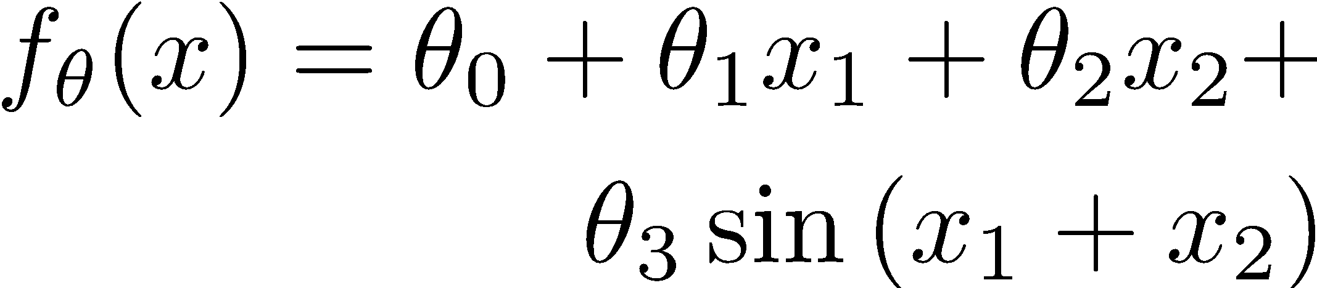
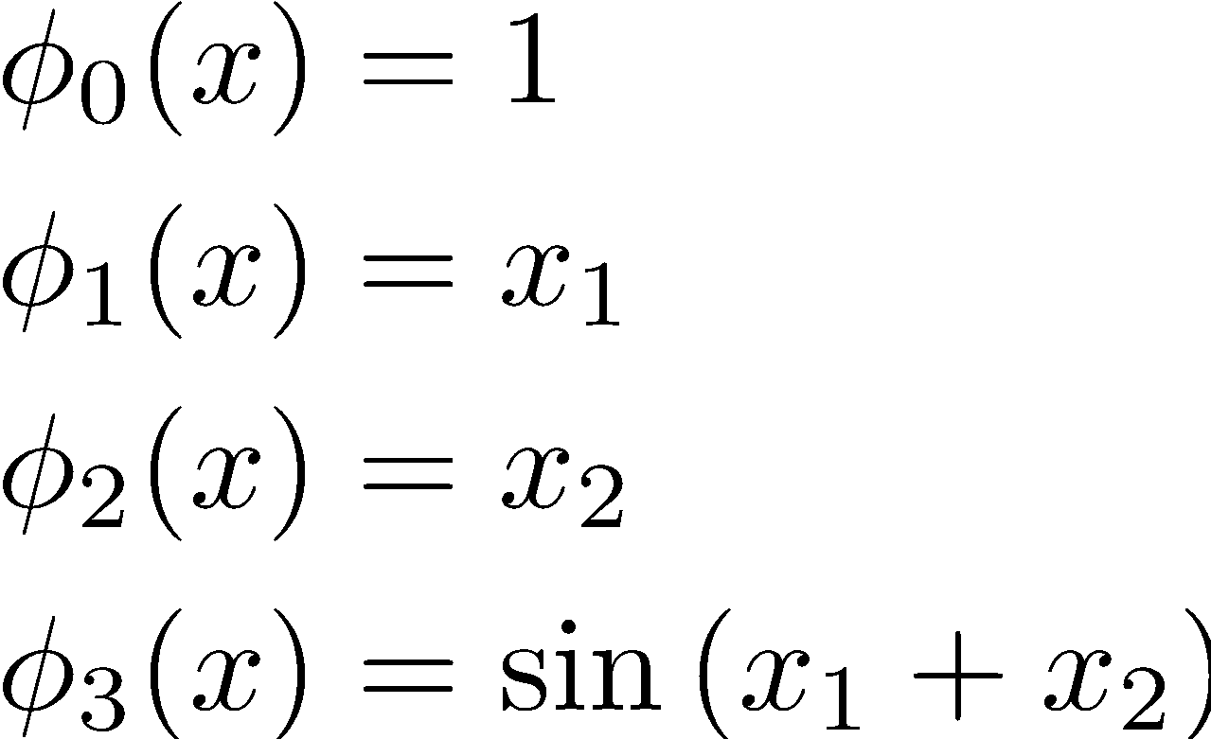
Modeling Non-linear Relationships
Feature Functions:
Note that feature functions don’t depend on parameters.

Slide 22
Focusing on Relationships between Features
The process of transforming the raw data to improve the accuracy of models.
  A key focus in many applications of data science.
Feature Engineering enables you to:
  capture domain knowledge (e.g., periodicity or relationships between features).
  express non-linear relationships using linear models.
  encode non-numeric features to be used as inputs to models.

Slide 23
Encoding categorical and text features

Slide 24
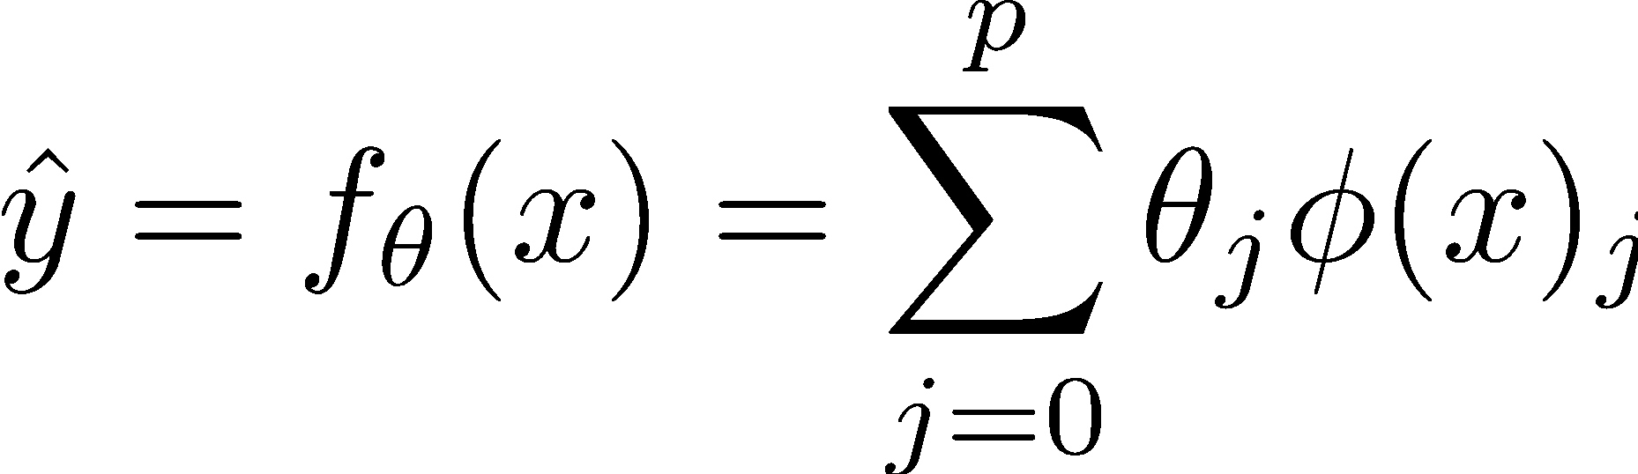
Encoding Categorical and Text Features
What if x is a record with numbers, text, booleans, etc...
X
Y
uid | age | state | hasBought | review
0 | 32 | NY | True | ”Meh.”
42 | 50 | WA | True | ”Worked out of the box …”
57 | 16 | CA | NULL | “Hella tots lit yo ...”
rating
2.0
4.5
4.1

Slide 25
Predict rating from review information
uid | age | state | hasBought | review
0 | 32 | NY | True | ”Meh.”
42 | 50 | WA | True | ”Worked out of the box …”
57 | 16 | CA | NULL | “Hella tots lit yo ...”
rating
2.0
4.5
4.1
Schema:
RatingsData(uid INTEGER, age FLOAT,
state STRING, hasBought BOOLEAN,
review STRING, rating FLOAT)

Slide 26
As a Linear Model?
RatingsData(uid INTEGER, age FLOAT,
state STRING, hasBought BOOLEAN,
review STRING, rating FLOAT)
uid | age | state | hasBought | review
0 | 32 | NY | True | ”Meh.”
42 | 50 | WA | True | ”Worked out of the box …”
57 | 16 | CA | NULL | “Hella tots lit yo ...”
rating
2.0
4.5
4.1
X=
Y=
Can I use X and Y directly in a linear model
  No! Why?
  Text, Categorical data, Missing values…
X
Domain

Slide 27
Basic Transformations
Uninformative features (e.g., UID)
  Is this informative (probably not?)
  Transformation: remove uninformative features (why?)
    They could influence the model.
Quantitative Features (e.g., Age)
  Transformation: May apply non-linear transformations (e.g., log)
  Transformation: Normalize/standardize (more on this later …)
    Example: (x – mean)/stdev
Categorical Features (e.g., State)
  How do we convert State into meaningful numbers?
    Alabama = 1 , …, Utah = 50 ?
    Implies order/magnitude means something … we don’t want that ...
  Transformation: One-hot-Encode

Slide 28
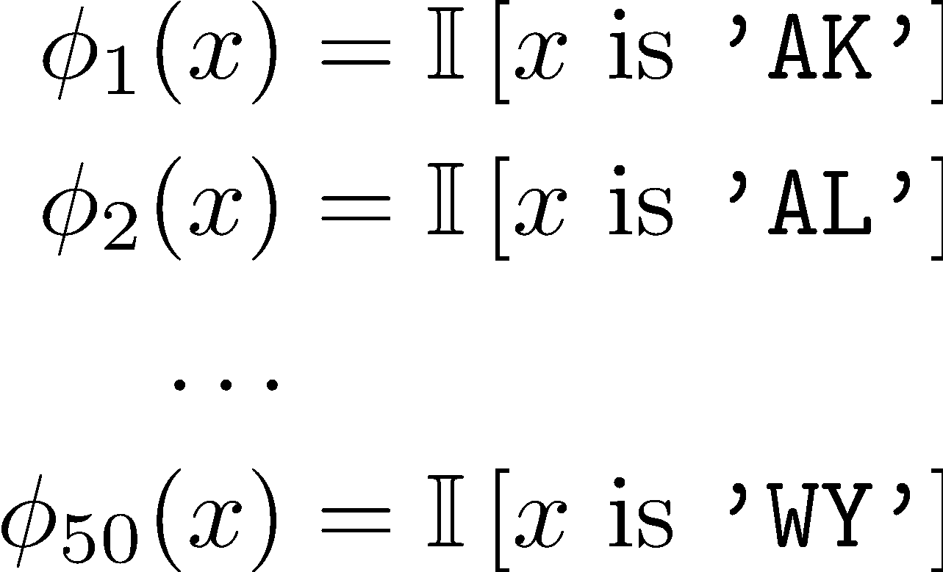
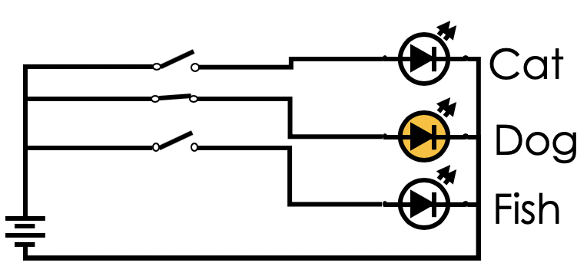
One-Hot Encoding (dummy encoding)
Transform categorical feature into many binary features:
state
NY
WA
CA
AK | … | CA | … | NY | … | WA | … | WY
0 | … | 0 | … | 1 | … | 0 | … | 0
0 | … | 0 | … | 0 | … | 1 | … | 0
0 | … | 1 | … | 0 | … | 0 | … | 0
Origin of the term: multiple “wires” for possible values one is hot…
Corresponding feature functions
See notebook for example code.

Slide 29
Encoding Missing Values
Missing values in Quantitative Data
  Try to impute (estimate) missing values… (tricky)
    Substitute the sample mean
  Add a binary field called “missing_col_name”. (why?)
    Sometimes missing data is signal!
Missing values in Categorical Data
  Add an addition category called “missing_col_name”

Slide 30
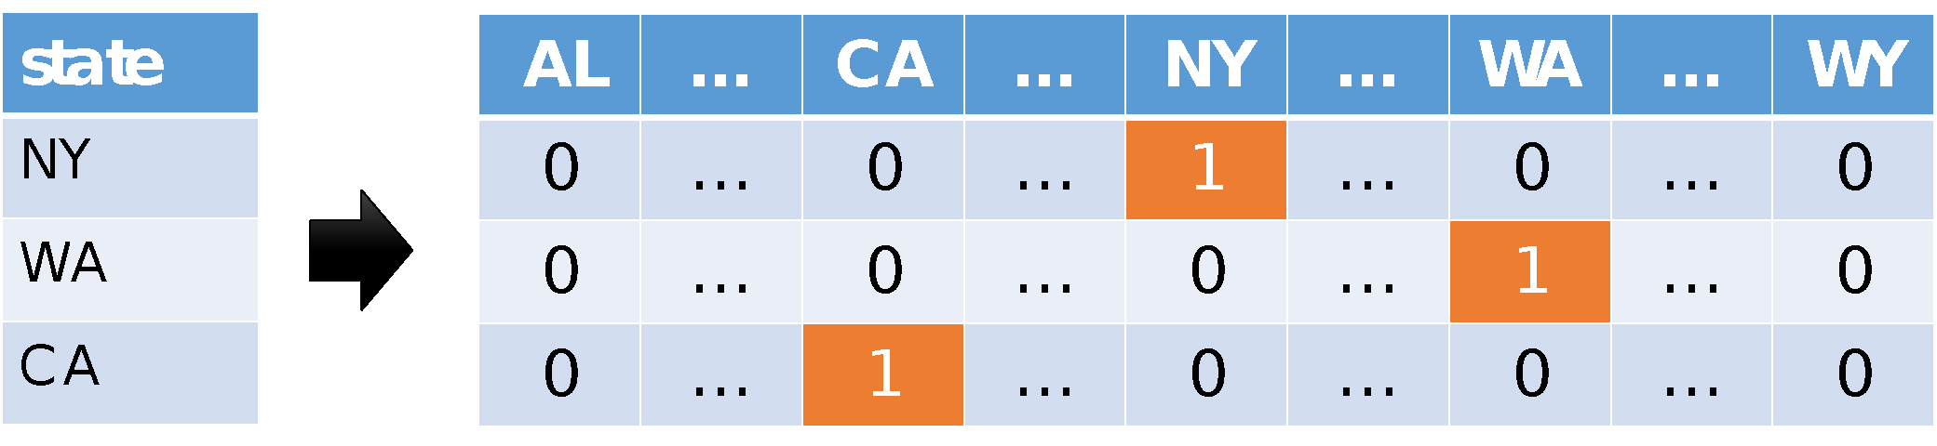
Encoding categorical data
Categorical Data: One-hot encoding.
Text Data: Bag-of-words & N-gram models.
“Learning about machine
learning is fun.”
aardwolf
learning
machine
aardvark
zyzzyva
fun
Vector
0
0
…
1
…
2
…
1
…
0

Slide 31
Bag-of-words Encoding
Generalization of one-hot-encoding for a string of text:
Encode text as a long vector of word counts (Issues?)
  Long = millions of columns – typically high dimensional and very sparse.
  Word order information is lost… (is this an issue?).
  New unseen words at prediction (test) time – drop them.
A bag is another term for a multiset: an unordered collection which may contain multiple instances of each element.
Stop words: words that do not contain significant information
  Examples: the, in, at, or, on, a, an, and, ...
  Typically removed.
“Learning about machine
learning is fun.”
aardwolf
learning
machine
aardvark
zyzzyva
fun
Vector
0
0
…
1
…
2
…
1
…
0

Slide 32

I (Joey) made this art piece in graduate school.
Do you see the stop word?
There used to be a dustbin and broom
…but the janitors got confused…

Slide 33
N-Gram Encoding
Sometimes word order matters:
How do we capture word order in a “vector” model?
N-Gram: “Bag-of- sequences-of-words”.
The book was not well written but I did enjoy it.
The book was well written but I did not enjoy it.

Slide 34
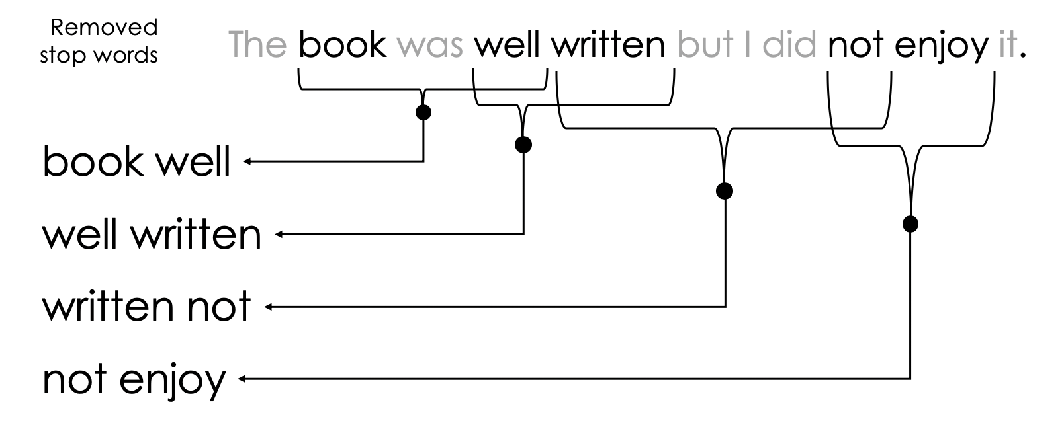
2-Gram Encoding
written not
well written
not enjoy
aardvark airlines
book well
apple pen
zyzzyva sf
Vector
0
0
…
1
…
1
…
1
…
1
…
0

Slide 35
N-Gram Encoding
Sometimes word order matters:
How do we capture word order in a “vector” model?
N-Gram: “Bag-of- sequences-of-words”.
Issues:
  Can be very sparse (many combinations occur only once)
  Many combinations will only occur at prediction time – drop
  Often use hashing approximation:
    Increment counter at hash(“not enjoy”) collisions are okay
The book was not well written but I did enjoy it.
The book was well written but I did not enjoy it.

Slide 36
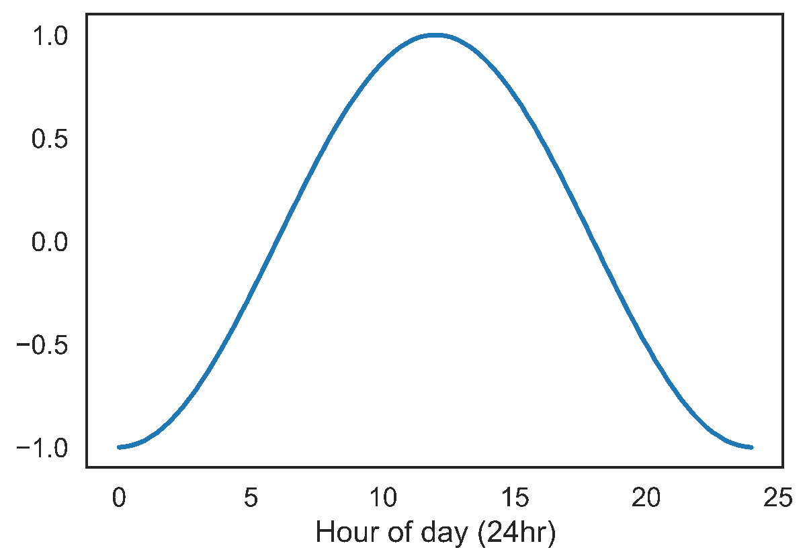
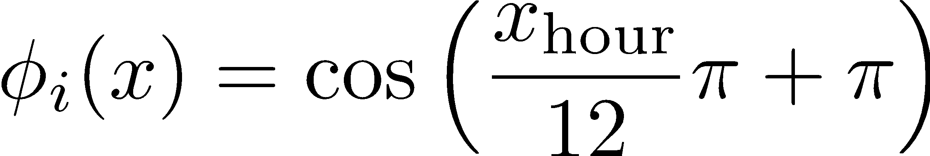
Feature Transformations to Capture Domain Knowledge
Feature functions capture domain knowledge by introducing additional information from other sources and/or combining features.
e.g. Encoding non-linear patterns:
Could do a database lookup
Diurnal patterns.

Slide 37
Pitfalls of Feature Engineering
Redundant features.
  When one feature is a linear combination of the others, there isn’t a unique solution for our parameter vector theta.
Too many features.
  When there are more columns than rows in our design matrix, there isn’t a unique solution for our parameter vector theta.
Overfitting.
  When we use too many complicated features, our model may fit to the “noise” in our collected data, and may not generalize to unseen data as well.
Automated Feature Extraction / Engineering
  Learn features in an automated way which may address some of the standard Feature Engineering issues

